Slide 1

InteliWound
InteliWound
InteliWound
Value-Based Wound Management

Slide 2
Project Description
The Wound Care Management System is a comprehensive mobile and web-based platform designed to streamline wound monitoring, treatment, and patient care for healthcare professionals. This solution enables clinicians to efficiently track wound healing progress, securely upload and store wound images, and maintain real-time patient records for accurate assessments.

Slide 3
Field Data Collection (Caretaker/Nurse)
Assigns roles and permissions, including to themselves.
Submits all data through structured visit notes with clinical observations.
Account Owner / Admin
Manages all user accounts within their organization.
Clinician Admin
Admits and discharges patients.
Reassigns patients to different organizations or care teams as needed.
Providers / Extenders (Nurse Practitioners, Physician Assistants)
Conduct patient visits and document clinical encounters.
Medical Billing Team
Reviews encounters currently in progress.
Processes encounters at the Superbill stage for billing and reimbursement.
Captures patient information via mobile device, including vital signs
Application workflow

Slide 4
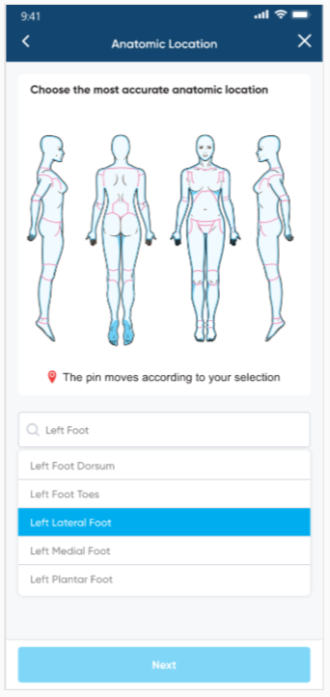
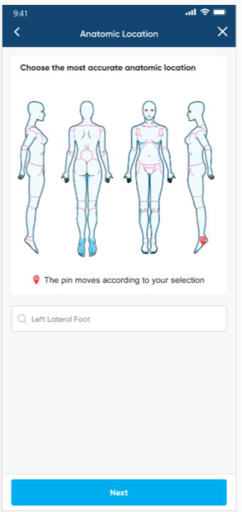
Anatomic Location
Use case 1
Step 1
Step 2

Slide 5
3D human body model
1. High Precision in Wound Mapping It accurately captures where the wound is located
2. Better for Multiple Wounds This prevents mixing up wound histories and measurements.
3. Supports Time-Based Analysis Generate longitudinal graphs per anatomical site
4. Enhances Remote Consultations Clinicians can visualize exactly where the wound is without in-person explanation.
5. Enables Advanced Analytics With consistent spatial labeling, the system can perform population-level analysis

Slide 6
3D Model

Slide 7
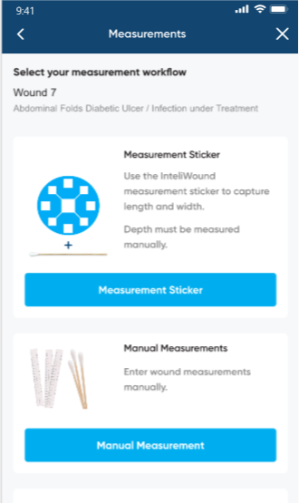
Wound Detection and Measurement

Slide 8
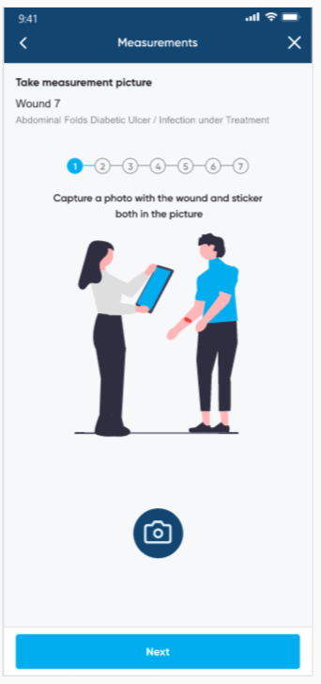
Photo Capture
Use case 2

Slide 9
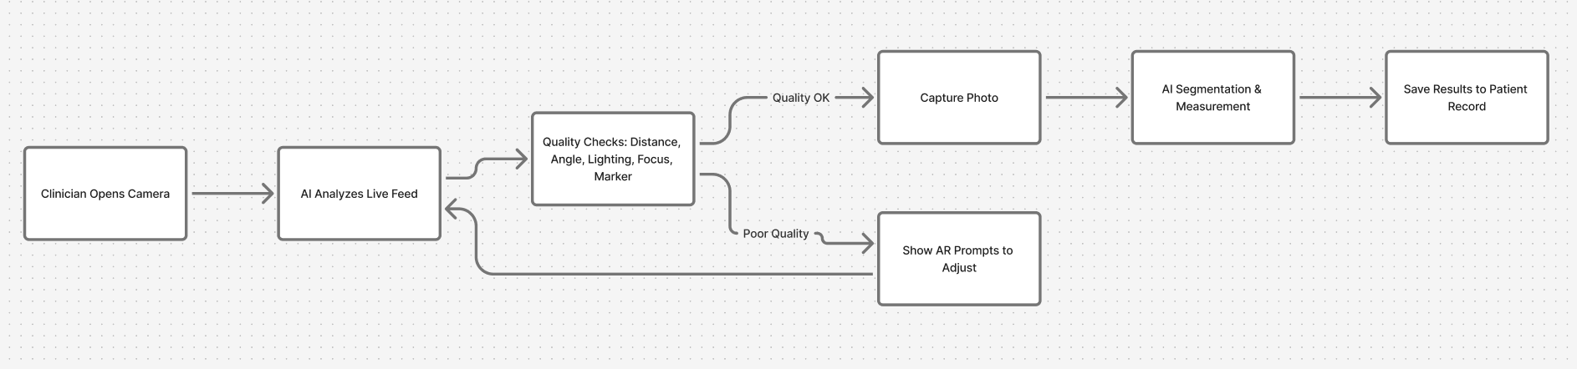
AI-Guided-Wound-Photo-Capture-Workflow

Slide 10
AI-Guided Photo Capture On-screen AR prompts (“move closer”, “adjust lighting”, “marker missing”). This ensures image quality, reduces reshoots.
How It Works
Using mobile computer vision and augmented reality (AR), the app gives on-screen prompts such as:
“Move closer”
“Adjust lighting”
“Increase focus”
“Reference marker missing”
“Angle too sharp—tilt forward”
Why It Matters
Eliminates poor-quality images that may compromise measurement accuracy.
Reduces the need for repeat photography and wasted clinical time.
Helps non-technical users (e.g., home caregivers, field health workers) capture standardized clinical photos.
Clinical Benefits
More consistent assessments over time.
Higher fidelity for segmentation and measurement algorithms.
Enables remote monitoring without requiring professional photography skills.

Slide 11
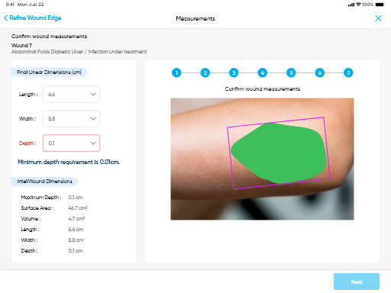
Wound Measurement
Use case 3

Slide 12
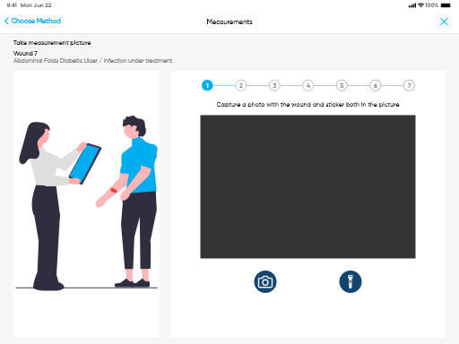
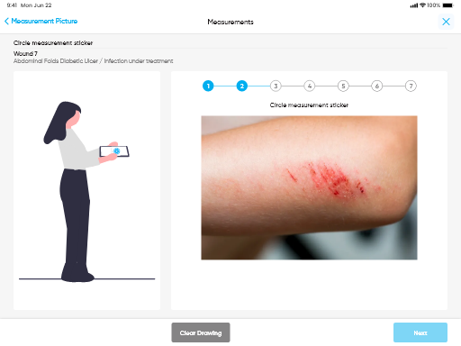
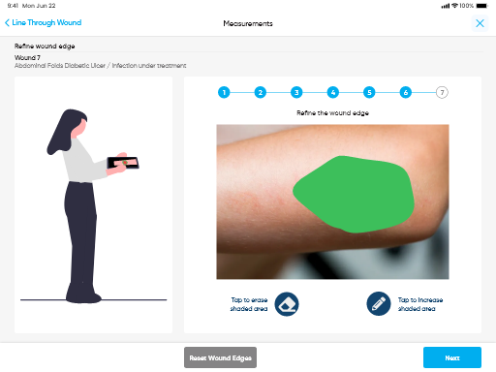

Slide 13
Tissue-Type Segmentation and Quantitative Composition This capability uses computer vision and deep learning to automatically analyze wound images and classify different tissue types present in the wound bed—typically granulation, slough, and necrotic tissue.
Key aspects:
Automated Identification: The AI model segments the wound area pixel-by-pixel, differentiating between tissue categories based on color, texture, vascularity, and visual patterns.
Quantitative Measurement: After segmentation, the system calculates the percentage composition of each tissue type (e.g., 45% granulation, 25% slough, 30% necrosis).
Clinical Value:
Helps clinicians assess the stage of healing more objectively.
Guides decision-making—for example:
High necrotic tissue → debridement required
Increasing granulation → wound healing progressing
Ensures consistent evaluation across different clinicians, reducing variability in assessment.
Use Case (MDPI and Research Supported): Studies show that automated segmentation improves accuracy and can reduce clinician workload while supporting clinical decision support systems.

Slide 14
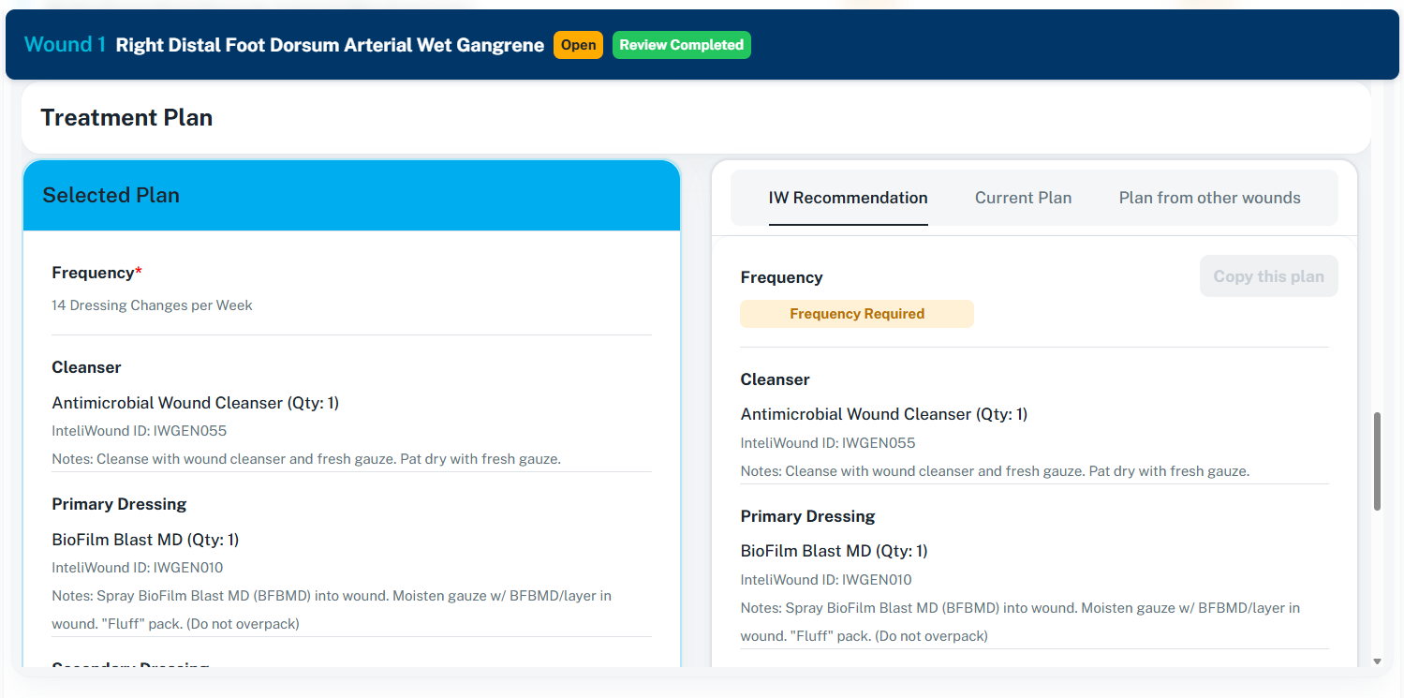
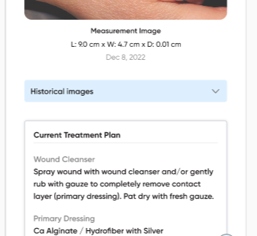
Use case 4
Healing Outcome Prediction

Slide 15
Predictive Modelling of Healing Outcome This refers to machine learning models that forecast the likely healing trajectory of a wound. The AI uses
Input Variables
Initial wound features:
Size, depth, tissue composition
Presence of infection
Wound edge condition
Patient-related factors:
Age, comorbidities (e.g., diabetes), circulation, nutrition, mobility
Past healing history
Outputs
Estimated probability of healing within a certain timeframe, e.g.:
“78% probability of complete closure within 6 weeks.”
Risk predictions, such as:
Infection risk
Delayed healing
Re-ulceration after closure
Clinical Impact
Enables personalized care plans.
Helps identify high-risk patients early, enabling:
More aggressive treatment
Faster referrals
Supports healthcare providers in:
Outcome reporting
Insurance/reimbursement justification
Benchmarking performance across patients or facilities

Slide 16
Documentation Automation & Reporting Automate generation of clinician notes (SOAP notes) based on captured image + questionnaire + AI summary. This reduces clinician time.
Use Case 5
What It Produces
Automatically generated clinical records such as:
SOAP Notes
Subjective
Objective
Assessment
Plan
Follow-up visit notes
Progress tracking reports
Discharge summaries
Value to Clinicians
Significantly reduces manual typing time, allowing providers to spend more time on patient care.
Standardizes clinical language, ensuring documentation quality.
Integrates into EHR/EMR systems for seamless workflow.
Generates clear audit trail and improves medico-legal compliance.

Slide 17
AI Triage Assistant Automatically prioritize wound cases in the backend based on severity and infection risk. Doctors can review urgent cases first
Use Case 6
How Triage Works
The AI scores each case based on:
Tissue health
Signs of infection (color, exudate, swelling, heat, odor, etc.)
Healing trend over time
Patient comorbidities and medical alerts
Output
Cases are automatically flagged with categories like:
High Priority (Review Immediately)
Likely Infection
Deteriorating Wound
Stable / Improving
Clinical Benefits
Doctors can review urgent cases first, even in large patient populations.
Reduces delays in treatment that may otherwise result in:
Hospitalization
Amputation
Serious infection
Helps remote healthcare models (telemedicine, community nursing, home care) function reliably and safely.

